Slide 1
CROHN’S DISEASE WITH ANAL FISTULATION - FAILED MEDICAL MANAGEMENT
PRESENTER: DR ANTONY KARIUKI, GENERAL SURGERY RESIDENT
SUPERVISOR: DR WILSON KIRAITU, GENERAL SURGEON

Slide 2
BIODATA
NAME: AOA
AGE: 20 YEARS
GENDER: MALE
ADRESS: MARSABIT
OCCUPATION: STUDENT
DOA: 12th NOV 2025

Slide 3
COMPLAINTS
Abdominal pain
Loose stool, blood stained
Duration of current complaints: one month

Slide 4
HISTORY OF PRESENTING ILLNESS
Known to have Crohn’s disease since age of 9 years
Complex anal fistula for 5 years
Has been on multiple therapies:
prednisolone tapered dose 2014 to 2021
infliximab injections 2014 to 2021
adalimumab 2021
left hemicolectomy, complex fistulotomy and seton placement Oct 2022 in India
vedolizumab from Nov 2022

Slide 5
HPI
Presented in current admission with passage of loose blood stained stool with clots for one month
Epigastric abdominal pain, gnawing character
Low appetite
Perianal swelling associated with pain and increased purulent discharge.
No fecal incontinence
Has had several readmissiosn due to flare ups and for EUA

Slide 6
PAST MEDICAL HISTORY
Several readmissions due to flare up of Crohn’s and for EUA
Has been transfused blood several times
Has undergone left hemicolectomy (2022)
Has been followed up for delayed development of secondary sexual chareacteristics
No known food or drug allergies

Slide 7
FAMILY AND SOCIAL HISTORY
2nd born of 7 children
Student - awaiting university admission
No history of alcohol or tobacco consumption
Has active SHA
No known family history of malignancy
Has family history of diabetes

Slide 8
PHYSICAL EXAMINATION
General examiantion:
Fair general examination
Moderately wasted
Vital signs: bp 115/84, hr 104, rr 18, temp 36.4, spo2 100% ra
ECOG 2
Abdominal examination:
Scaphoid, with extended midline scar
Mild generelised tenderness
Soft
No palpable masses/organomegaly

Slide 9
PHYSICAL EXAMINATION
Rectal examination:
Three sinus openings on the right gluteal region, oozing pus
Severe tenderness of the perianal region especially on the right
Digital assessment of the anal canal limited by severe tendernes

Slide 10
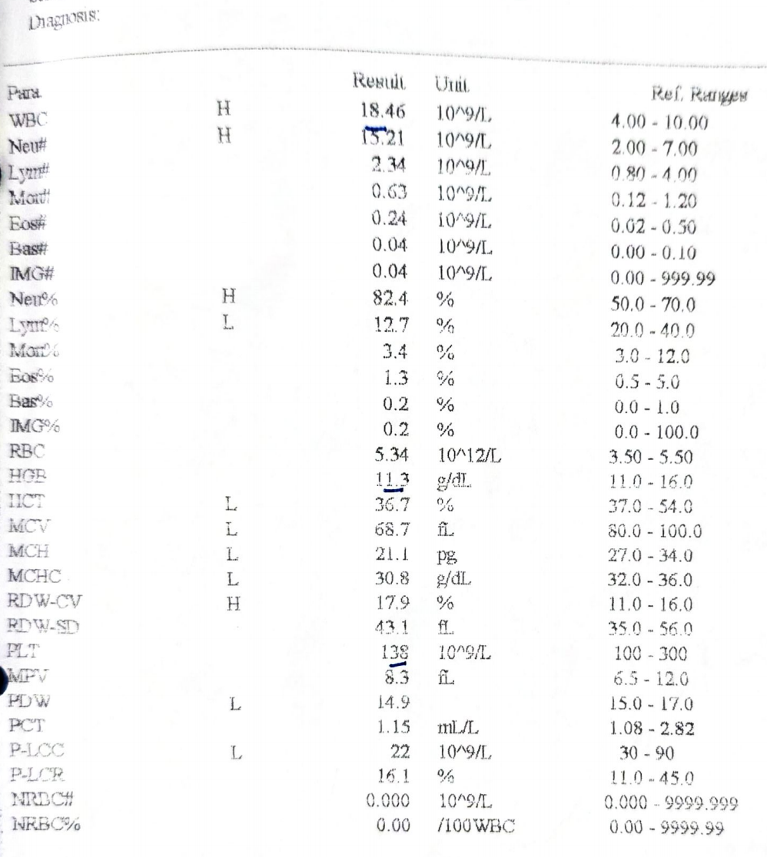
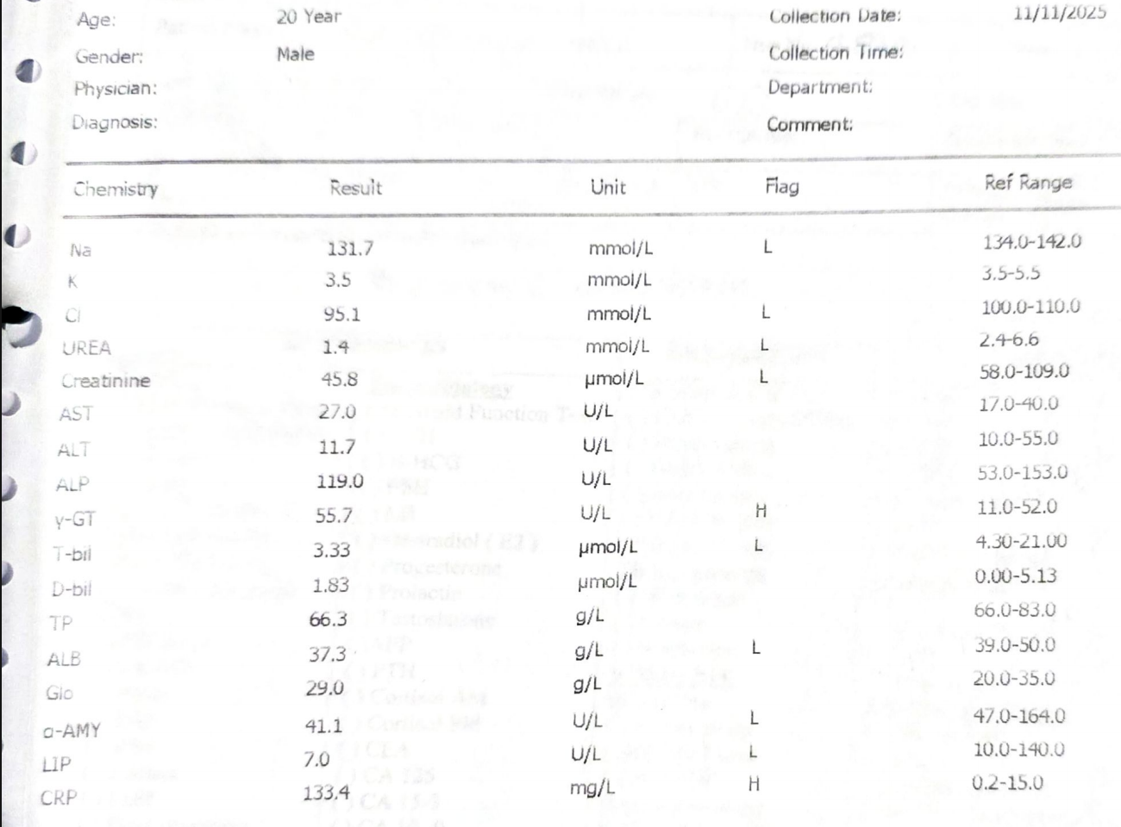
INVESTIGATIONS

Slide 11
INVESTIGATIONS
Culture of pus from anal fistula done proir to this admission:
E coli, multi drug resistant, sensitive to amikacin and meropenem

Slide 12
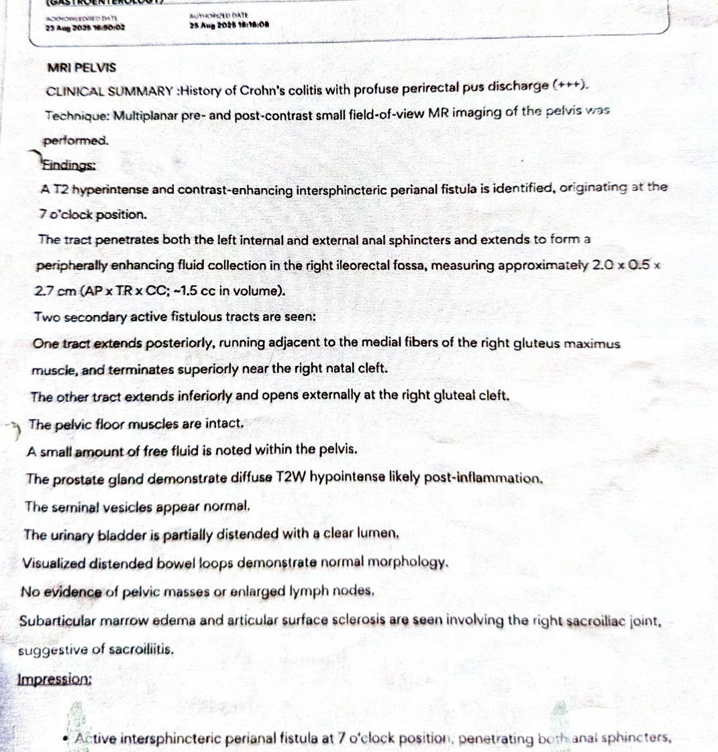
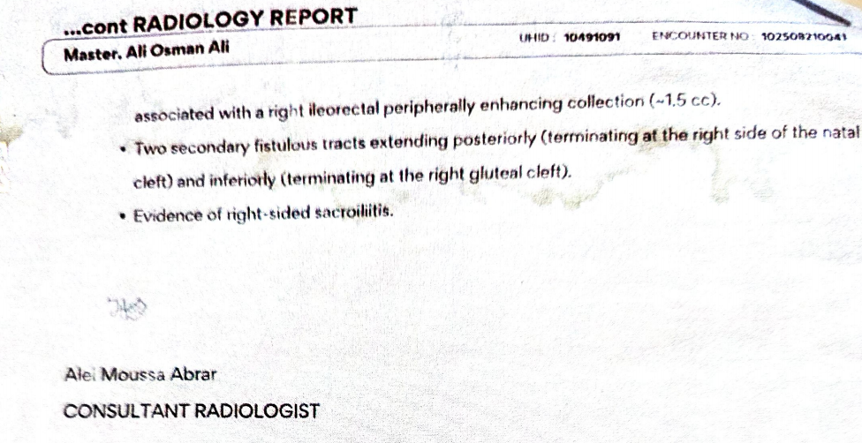
INVESTIGATIONS: MRI PELVIS

Slide 13
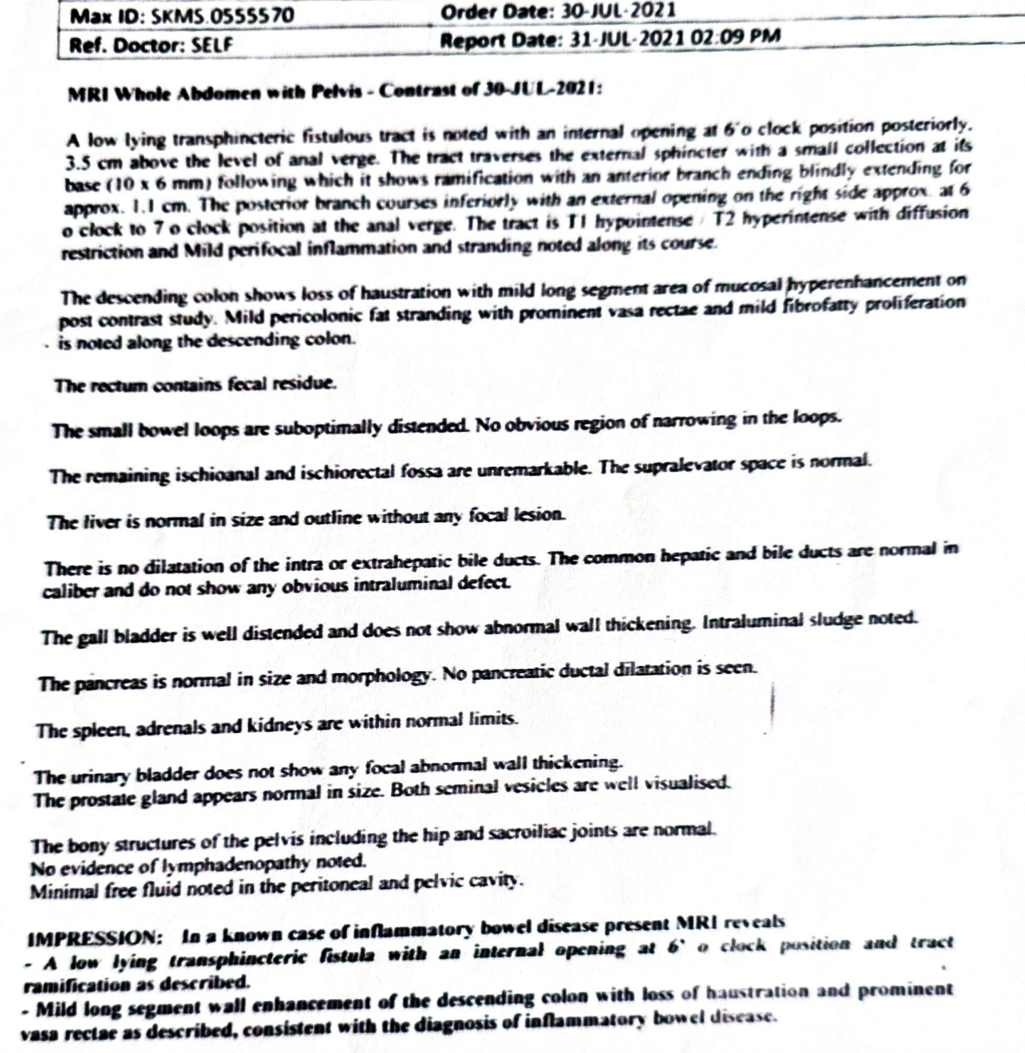
INVESTIGATIONS: PELVIC MRI

Slide 14
INVESTIGATIONS: ABDOMINAL AND PELVIC MRI
A low lying transphicteric fistula with an internal opening at 6 oclock and tract ramifications
Mild long segment wall enhancement of the descending colon with loss of haustrations and prominent vasa recta, consistent with IBD

Slide 15
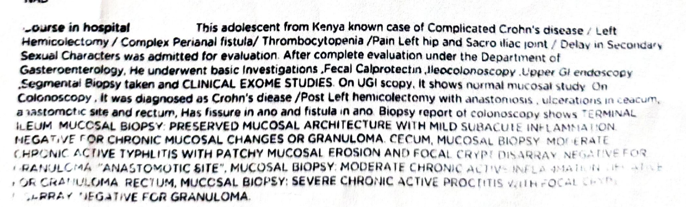
INVESTIGATIONS: ENDOSCOPY + BIOPSY

Slide 16
INVESTIGATIONS: ENDOSCOPY + BIOPSY
OGD: normal
Colonoscopy: ulcerations in caecum, anastomosis site and rectum. fissure in ano. Fistula in ano.
Histology:
preserved terminal ileum mucosal architecture with mild subacute inflammation.
caecum: moderate active typhilitis with patchy mucosal erosion and focal crypt disarray, neg for granuloma
anastomotic site: moderate active inflammation neg for granuloma
rectum: severe chronic active proctitis with focal crypt disarray neg for granuloma

Slide 17
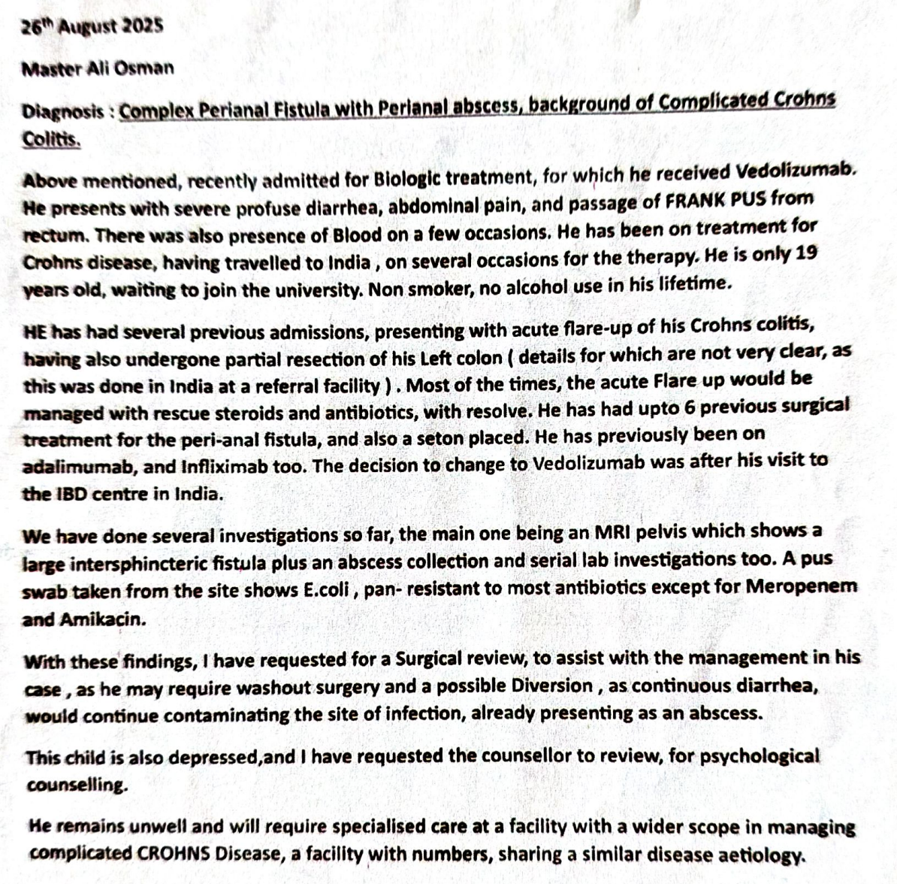
PREVIOUS MEDICAL REPORTS

Slide 18
CURRENT TREATMENT
Meropenem
Morphine
Paracetamol
Acupan
Metoclopramide
Ondansetron
Esomeprazole
Clexane
RL
Sits baths
Nutritional support

Slide 19
SUMMARY
AOA, a 20 year old male from Marsabit, on management for Crohn’s disease with fistulation with failed management on biologic agents, presenting with a one month history of passing loose watery blood stained stool, abdominal pain, and increased purulent discharge from the anal fistulae

Slide 20
QUESTION TO THE MDT
What is the way forward in management of this patient?

